Slide 1

PORTFOLIO OPTIMIZATION USING KNAPSACK

Slide 2
Group Members :
ARUSHI SINGH ( RA2211003010847 )
R. AKASH ( RA2211003010863 )
SIVANI S IYER ( RA2211003010865 )

Slide 3
PROBLEM STATEMENT :
Design and implement a portfolio optimization system using a knapsack algorithm. Upon user request, the system should optimize the portfolio by selecting a combination of assets that maximizes the total value while adhering to a specified risk constraint (knapsack capacity). Display the optimized portfolio's total value and the details of the selected assets to the user.

Slide 4
WHY KNAPSACK ?
1. Knapsack algorithms efficiently select the best combination of assets to maximize portfolio value while adhering to specified risk constraints.
2. They offer optimal solutions, scalability, and ease of implementation, making them a preferred choice for portfolio optimization in real-world investment scenarios.
3.Flexibility: Knapsack algorithms allow for flexibility in defining constraints. In portfolio optimization, this flexibility enables users to specify risk constraints, budget constraints, or other criteria to tailor the portfolio according to their investment objectives.
4.Scalability: Knapsack algorithms scale well with increasing numbers of assets, making them suitable for real-world portfolio management scenarios where the number of investment options may be extensive.

Slide 5
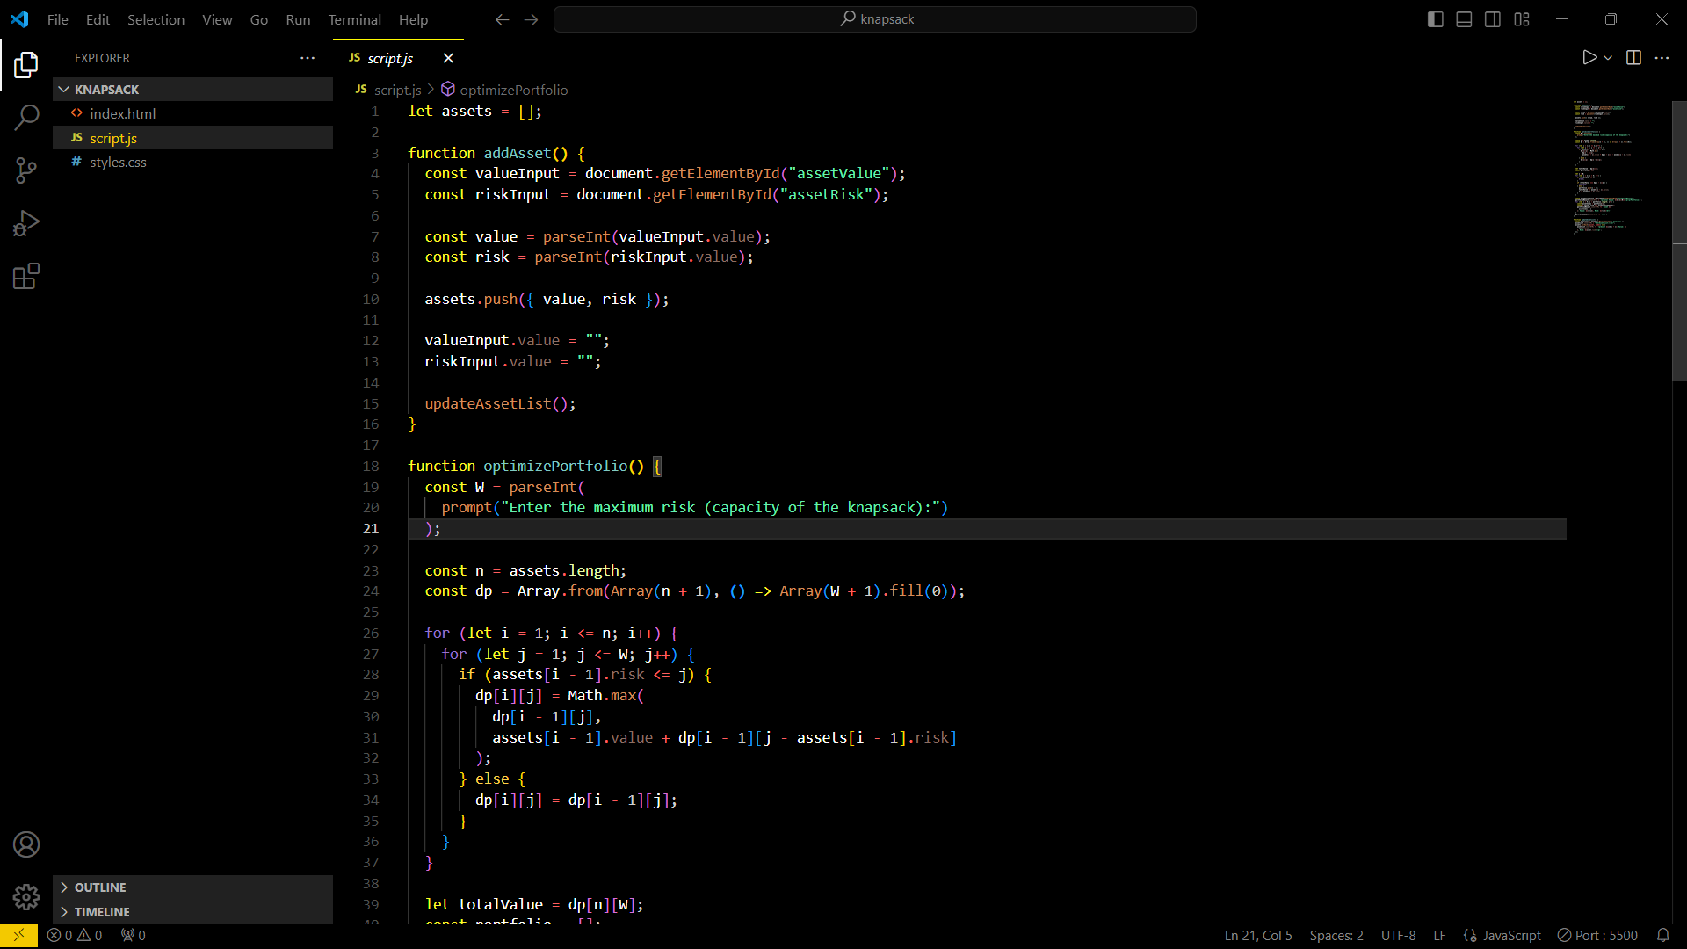
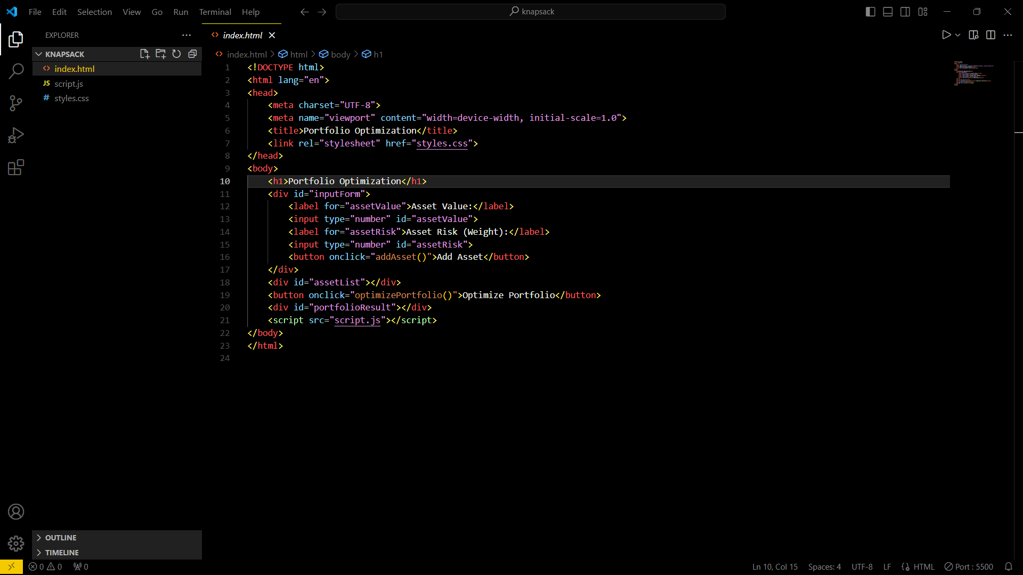
CODE SNIPPET :
JAVASCRIPT : HTML :

Slide 6
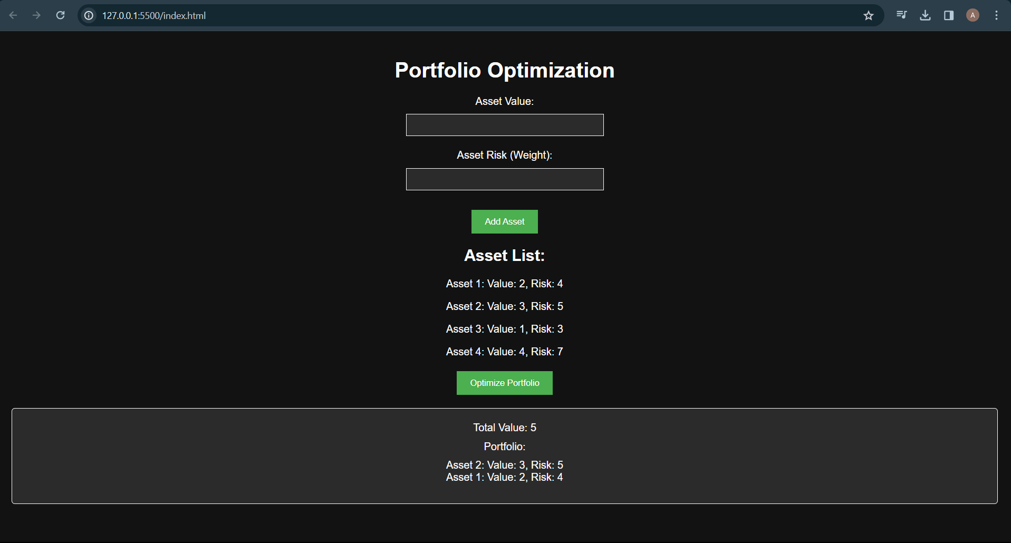
OUTPUT :

Slide 7
CONCLUSION :
In conclusion, employing a knapsack algorithm for portfolio optimization provides a robust and efficient method to select an optimal combination of assets that maximizes portfolio value while respecting risk constraints. Its scalability, optimality, and ease of implementation make it a valuable tool for investment professionals seeking to construct well-balanced and high-performing portfolios tailored to specific investment objectives and constraints.

